Slide 1
Image generation

Slide 2
Some architectures

Slide 3
Dimensionality reduction
Selection(leave only chosen features)
Extraction(new features are created)

Slide 4
let’s call encoder the process that produce the “new features” representation from the “old features” representation (by selection or by extraction)
decoder the reverse process.

Slide 5
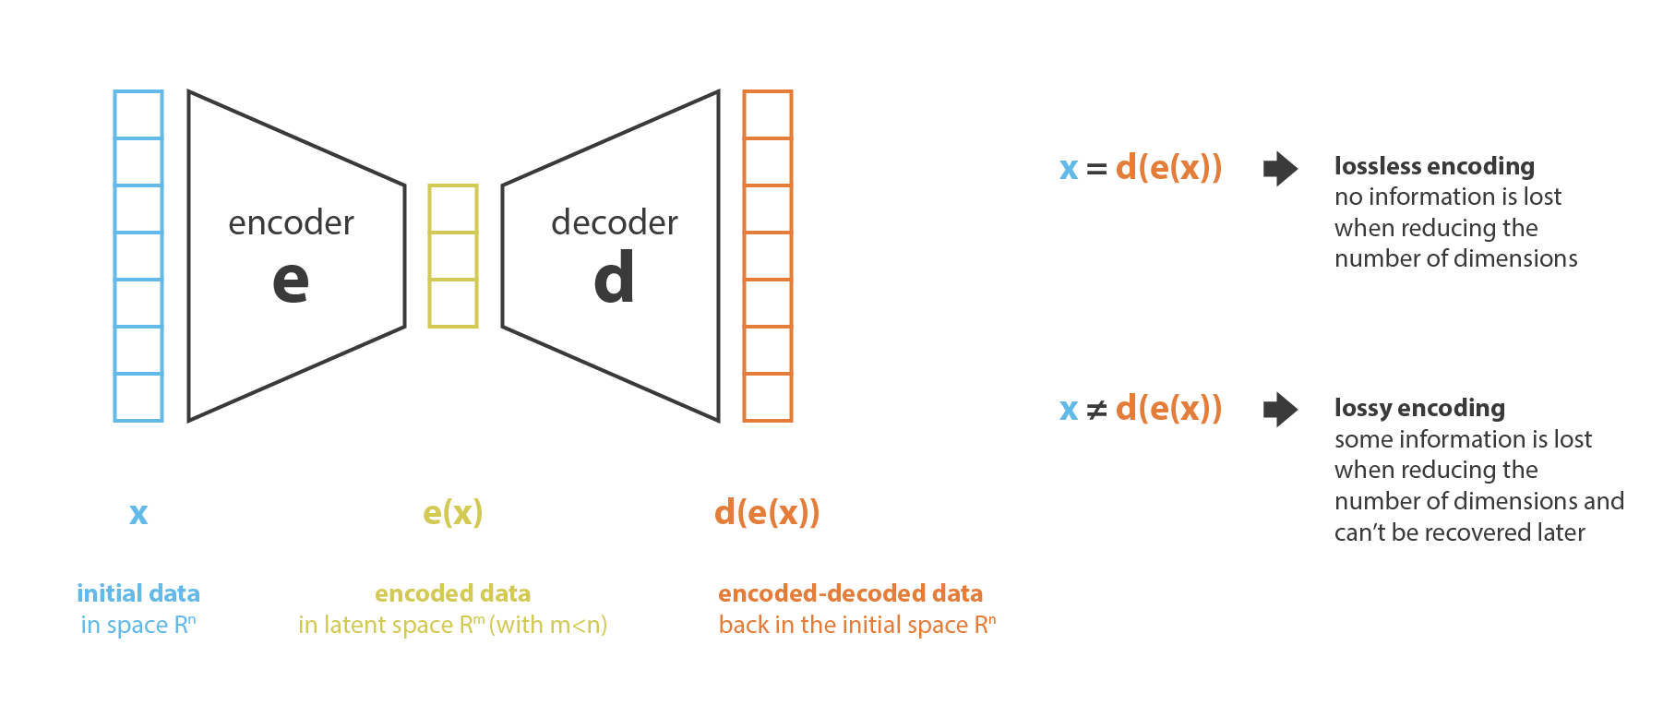

Slide 7
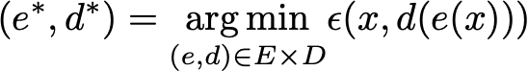

Slide 8
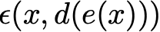
Reconstruction error

Slide 9
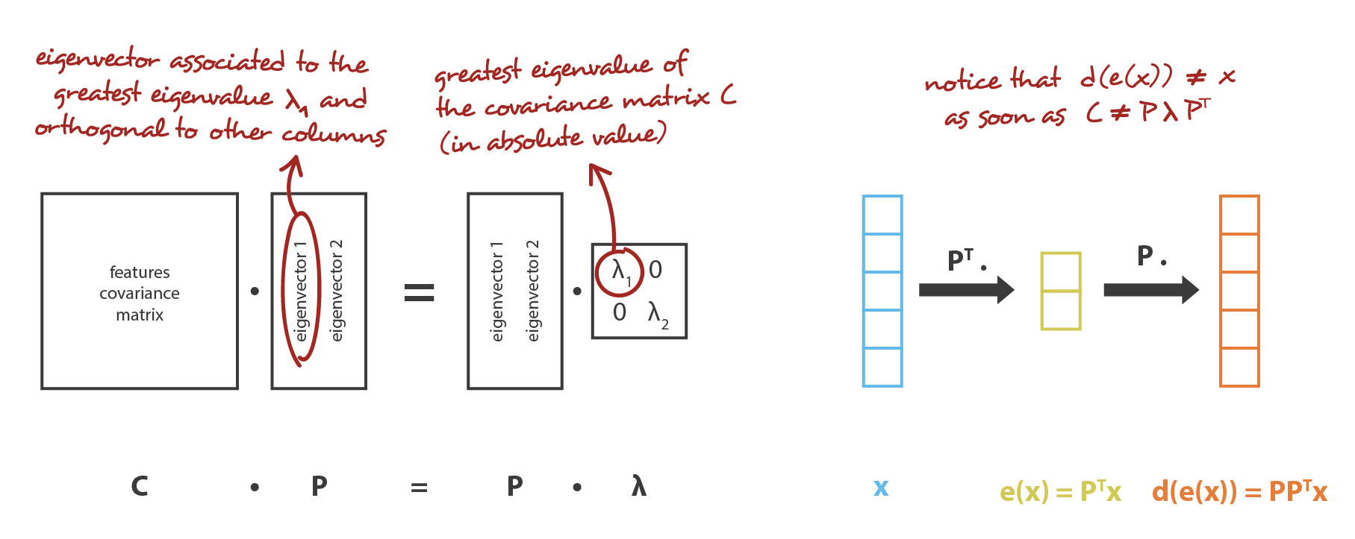
PCA

Slide 10
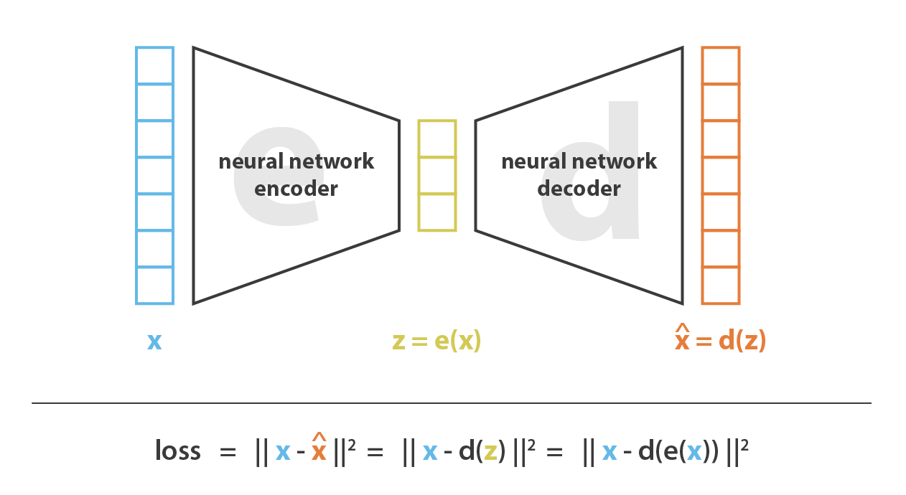
Autoencoder

Slide 11
What if?
Decoder and Encoder - are just one linear layer(without non-linearity)

Slide 12
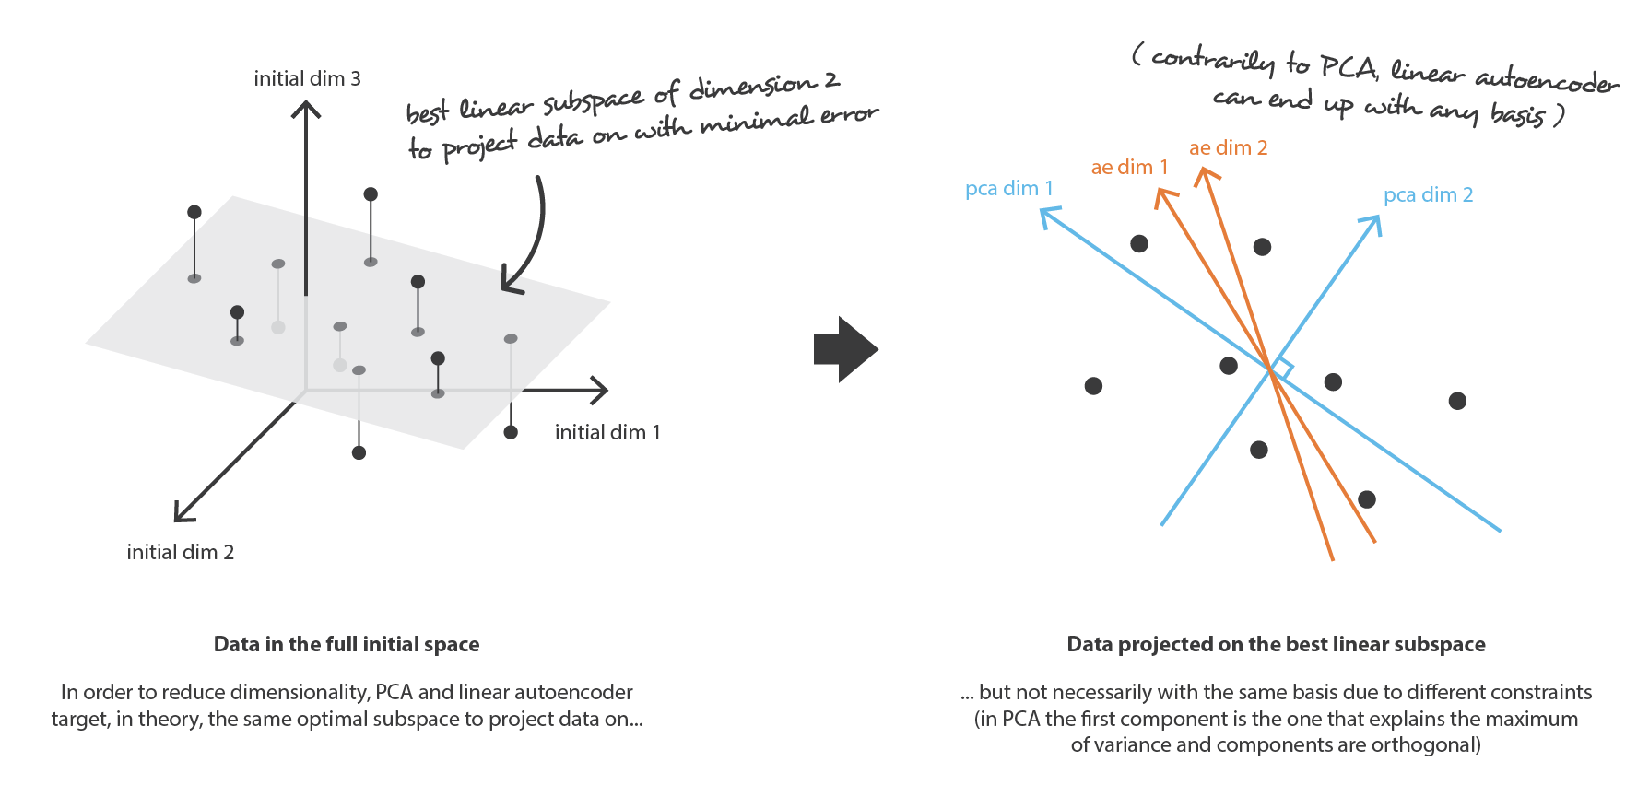

Slide 13
What if?
Decoder and Encoder - are just one linear layer(without non-linearity)
Decoder and Encoder - both deep and non-linear

Slide 14
Problems
Lack of regularity(hard to make sense of latent space)
Goal is to reduce the number of dimensions

Slide 15
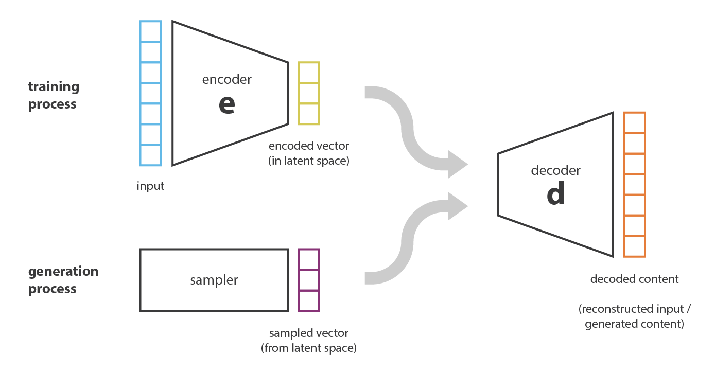

Slide 16
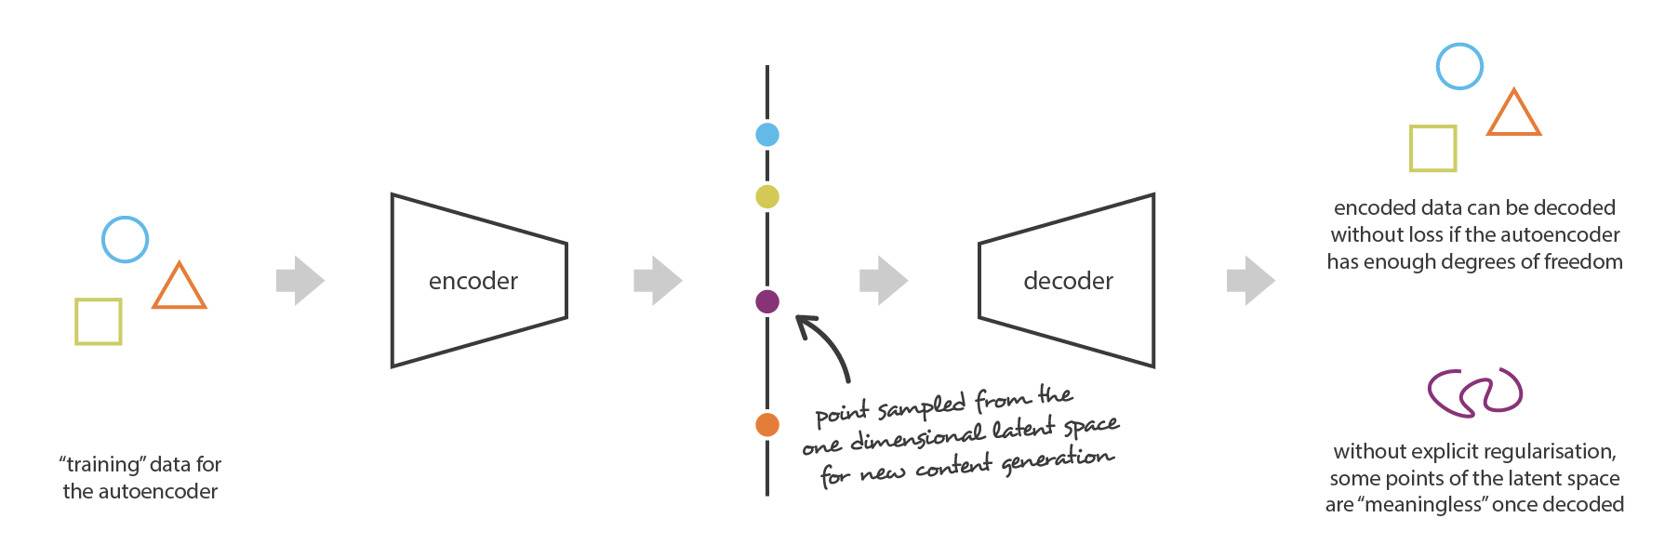

Slide 17
Variational autoencoder
can be defined as being an autoencoder whose training is regularised to avoid overfitting and ensure that the latent space has good properties that enable generative process

Slide 18
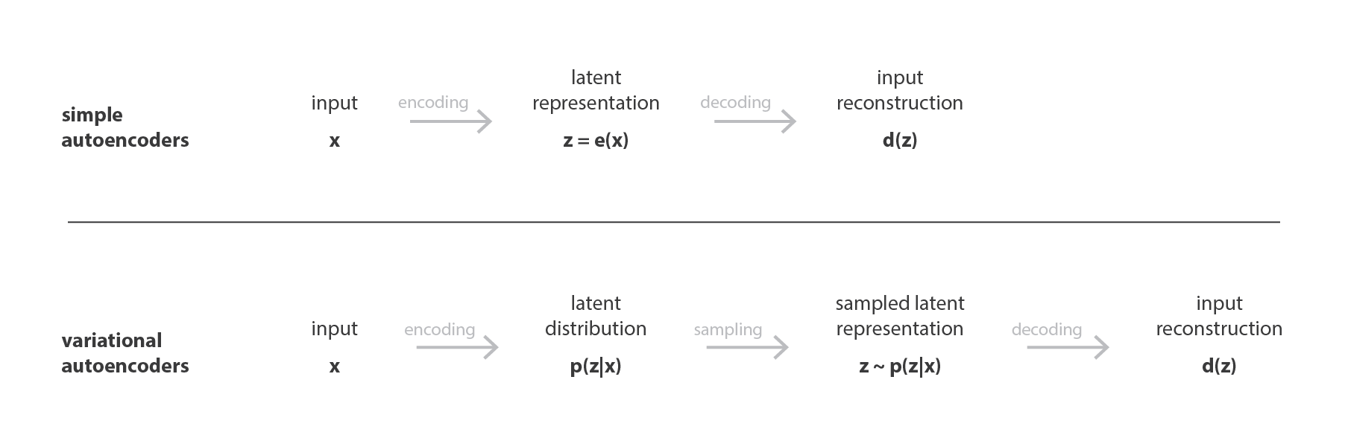

Slide 19
Training process
the input is encoded as distribution over the latent space
point from the latent space is sampled from that distribution
the sampled point is decoded and the reconstruction error can be computed
the reconstruction error is backpropagated through the network

Slide 20
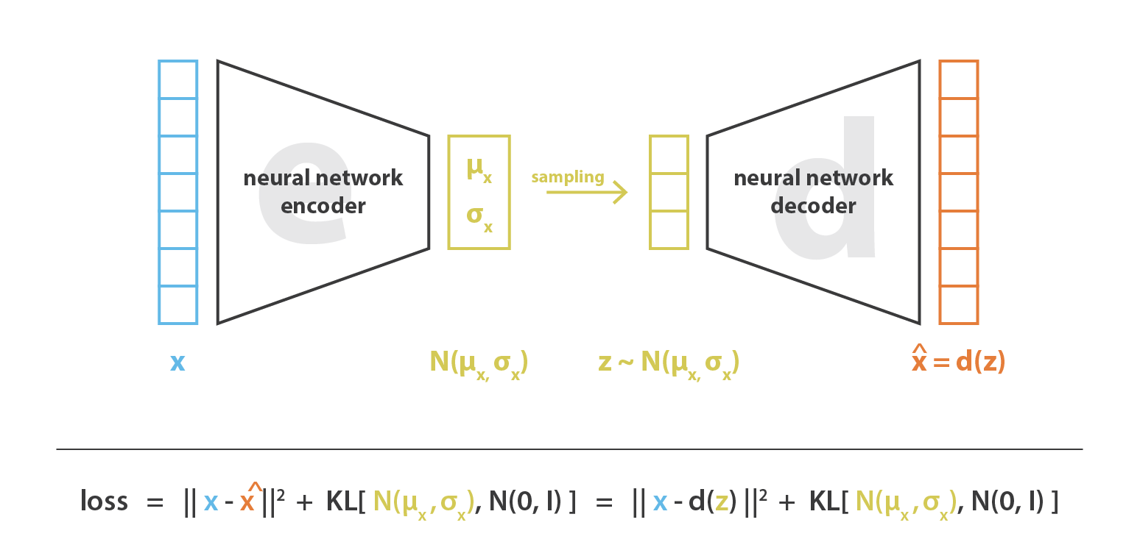

Slide 21
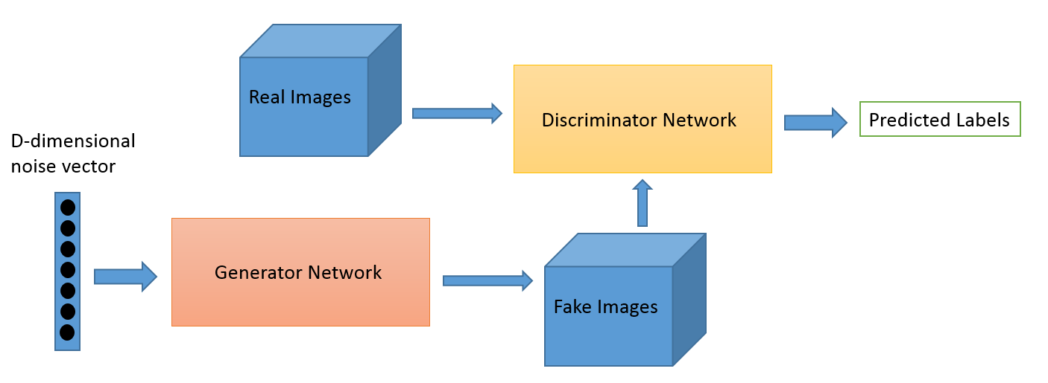
Generative adversarial networks

Slide 22
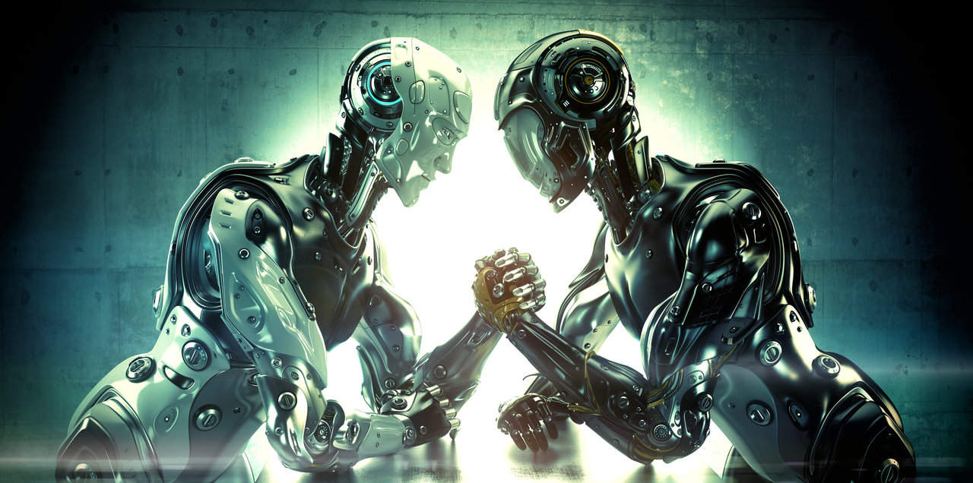

Slide 23
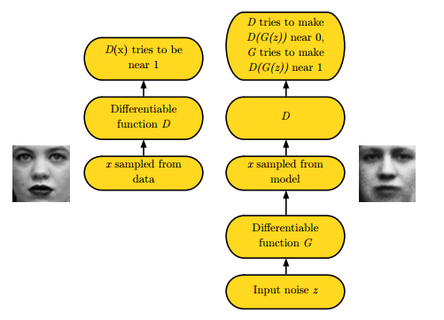
Intuitive explanation

Slide 24
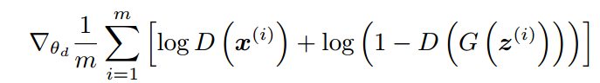
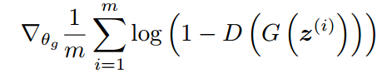
GAN training process
Update the discriminator by ascending its stochastic gradient:
Update the generator by descending its stochastic gradient:

Slide 25

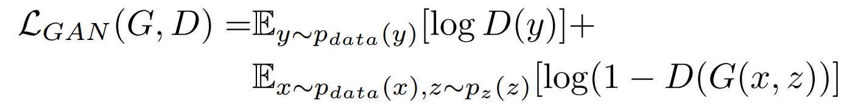
What do we optimize in GAN?

Slide 26
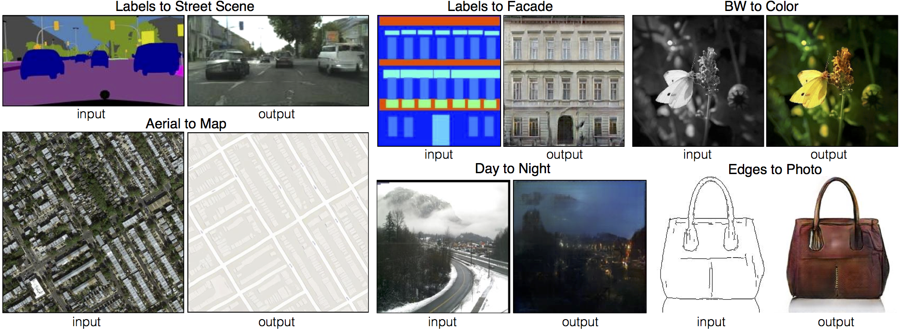
pix2pix

Slide 27
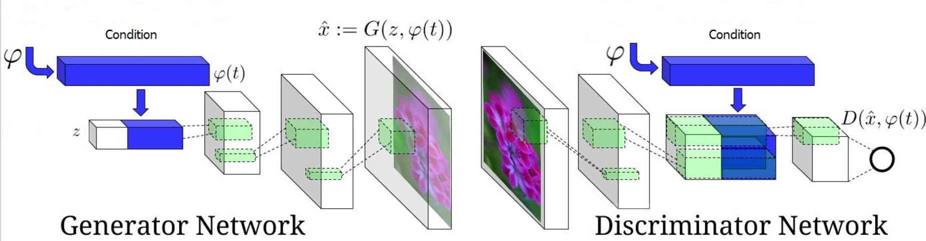
Conditional GAN

Slide 28
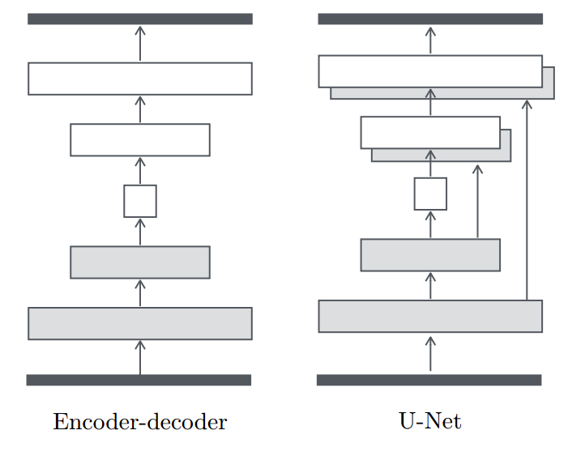
Generator

Slide 29

Convolution

Slide 30

Convolution

Slide 31

Convolution

Slide 32

deconvolution(transposed convolution)

Slide 33

deconvolution(transposed convolution)

Slide 34
deconvolution(transposed convolution)

Slide 35
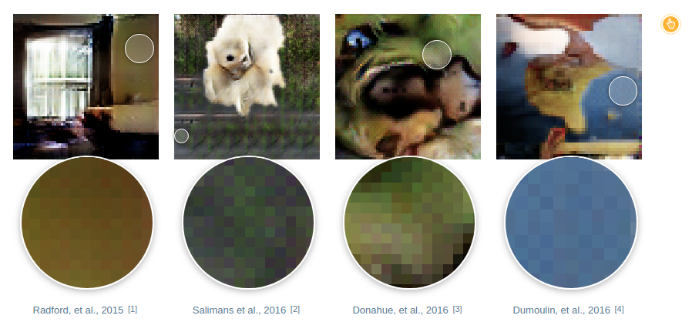
Possible problems: checkerboard artifacts

Slide 36
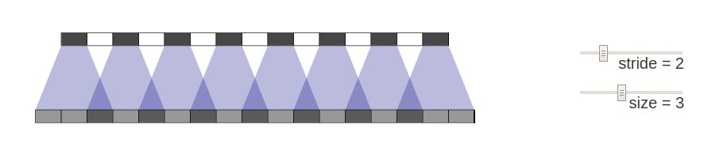
Possible problems: checkerboard artifacts

Slide 37
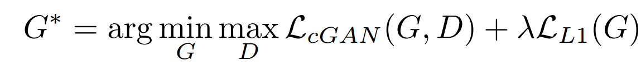
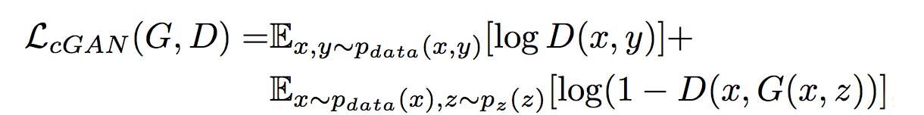
What do we optimize?

Slide 38
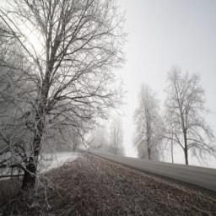
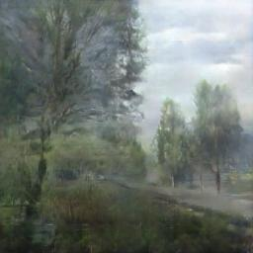
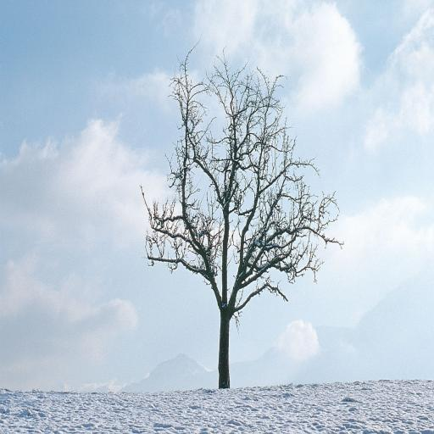
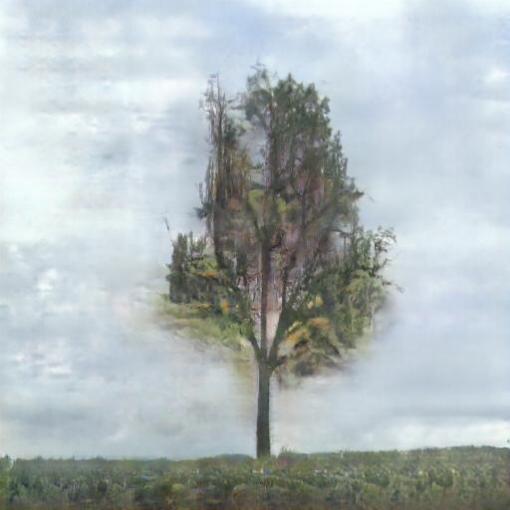
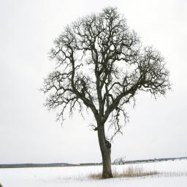
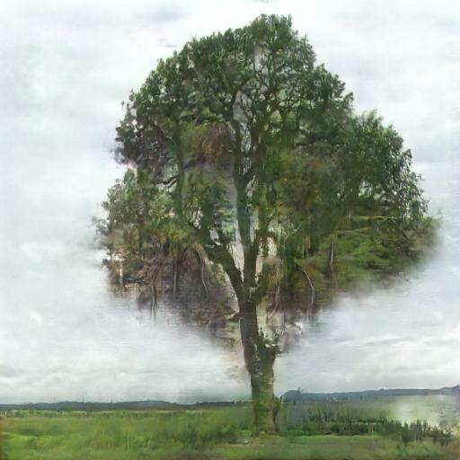
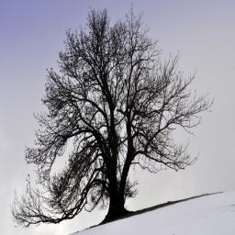
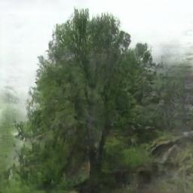
Notable results

Slide 39
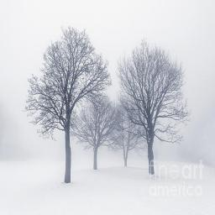
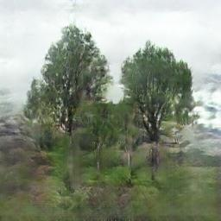
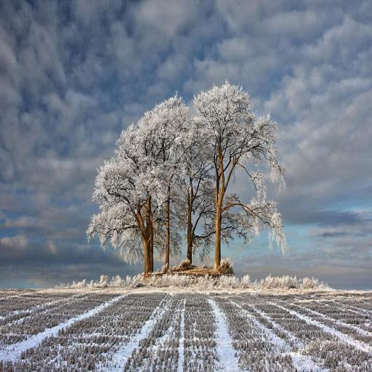
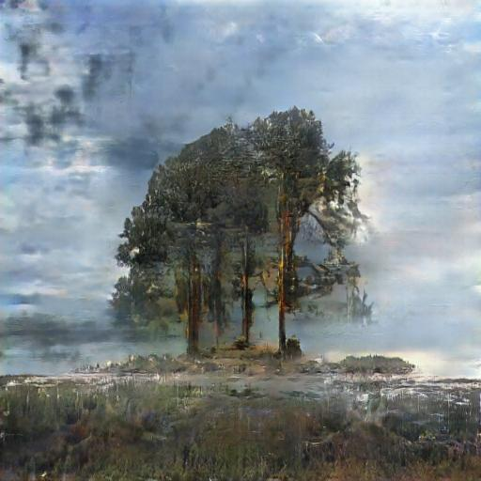
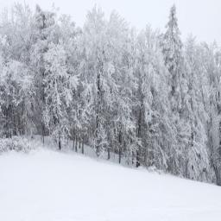
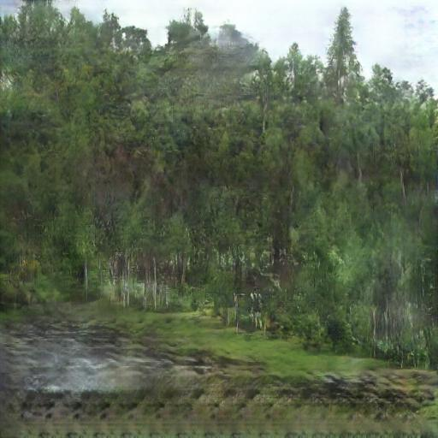
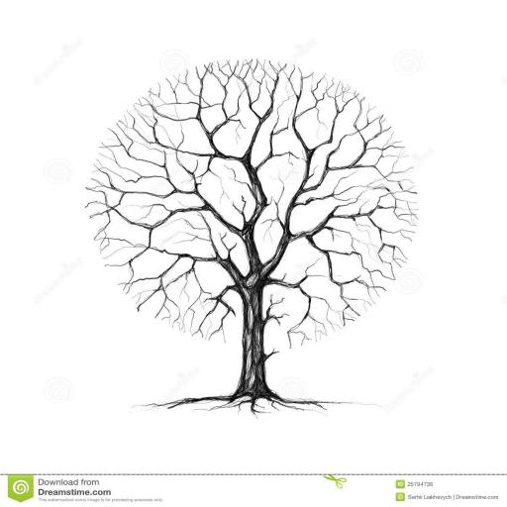
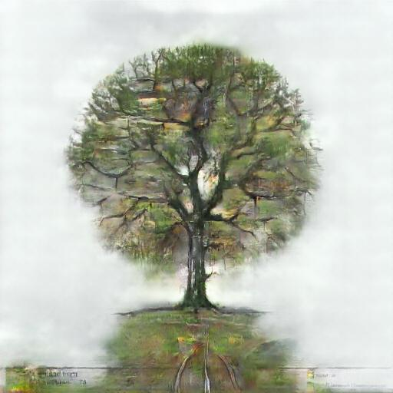
Notable results

